Slide 1

Metalanguage as an Interdisciplinary Classifier for Mathematics and Computer Science Fields
24-2-R-10
Students: Alex Pitkin 333879013 & Ilya Vorotyntsev 324755735
Supervisors: Elena Kramer & Dr. Dan Lemberg

Slide 2
Agenda
Introduction
Motivation
Problem Statement
Main Goal
Proposed Work
Dataset Collection
Text Preprocessing
Text Classification
Text Clustering
Testing Plan
Expected Results
Q&A

Slide 3
1. Introduction

Slide 4

Why we choose this project?
Did you know that many students excel in computer science but struggle with mathematics, or vice versa?
Many students struggle differently in mathematics and computer science.
Although Math and CS both rely on logic and problem-solving skills, students often find one subject more challenging than the other. This suggests that there are unique aspects in how these subjects are taught and understood.

Slide 5
State-of-Art
Can we understand a subject without its specific vocabulary?
Conventional text classification relies heavily on subject-specific terms.
Traditional models focus on keywords unique to each field, like "algorithm" in computer science or "integral" in mathematics. This reliance can limit the ability to generalize across different subjects.
Such approach overlooks deeper linguistic structures common across fields.
By concentrating on terminology, we miss out on analyzing the way ideas are expressed—the syntax, sentence structure, and function words that form the backbone of language in educational texts.
There's a need to classify texts based on general language patterns (metalanguage) rather than terminology.
Exploring the metalanguage allows us to understand how concepts are communicated, independent of specific jargon, revealing insights into teaching methods and cognitive processes involved in learning.
Our goal is to identify these patterns to distinguish between fields in math and CS.
By identifying subtle linguistic differences, we aim to accurately classify texts and ultimately contribute to personalized education by adapting materials to individual learning styles.

Slide 6
Our Approach
Can we understand a subject without its specific vocabulary?
Conventional text classification relies heavily on subject-specific terms.
Traditional models focus on keywords unique to each field, like "algorithm" in computer science or "integral" in mathematics. This reliance can limit the ability to generalize across different subjects.
There's a need to classify texts based on general language patterns (metalanguage) rather than terminology.
Exploring the metalanguage allows us to understand how concepts are communicated, independent of specific jargon, revealing insights into teaching methods and cognitive processes involved in learning.
Our goal is to identify these patterns to distinguish between fields in math and CS.
By identifying subtle linguistic differences, we aim to accurately classify texts and ultimately contribute to personalized education by adapting materials to individual learning styles.
Such approach overlooks deeper linguistic structures common across fields.
By concentrating on terminology, we miss out on analyzing the way ideas are expressed—the syntax, sentence structure, and function words that form the backbone of language in educational texts.

Slide 7
Explore the Existence of a Similar Metalanguages Across Fields
Identify Shared Linguistic Structures
We seek to uncover the common ways in which concepts are communicated across different subjects, focusing on syntax, grammar, and general vocabulary.
Assess the Potential for Cross-Disciplinary Teaching Tools
If a common metalanguage exists, it could inform the development of educational resources that bridge gaps between subjects, aiding in interdisciplinary learning.

Slide 8
2. Proposed Work

Slide 9
Dataset Collection
We will collect freely accessible academic books in mathematics and computer science fields from the internet.
Each book will be individually reviewed to ensure its relevance and suitability for our research objectives.
Our dataset will include both original PDFs and scanned PDFs (images of book pages rather than embedded text).
Mathematics | Computer Science
Linear Algebra | Data structures and Algorithms
Abstract Algebra | Object Oriented Programming
Calculus | Imperative Programming
Combinatorics | Functional Programming
Probability | Operation Systems
Logic | Compilation
Set theory | Automata and Formal Languages
Text Extraction Techniques:
For Original PDFs: We will experiment with text extraction tools such as PyMuPDF (Fitz), pdfminer.six, and PyPDF2 to handle complex PDF structures.
For Scanned PDFs: We will employ Tesseract OCR to convert image-based PDFs into machine-readable text.

Slide 10
Text Preprocessing
1. Removing Irrelevant Content
We will eliminate sections not directly related to the subject matter, such as bibliographies, tables of contents, and indices. Special algorithm will be developed to find and exclude these pages; if unsuccessful, we will use predefined, hard-coded values.
2. Standardizing Text
We will convert all characters to lowercase, remove punctuation marks, extra whitespace, and numerical values to retain only alphabetic characters and spaces.
3. Filtering Non-Standard Words
We will use the wordfreq library to remove irrelevant or rare words by retaining only terms of minimum frequency and at least two characters in length.
4. Linguistic Normalization
We will apply NLP techniques using NLTK for stemming(reduce words to their base or stem form by removing suffixes and prefixes) and lemmatization(reduce words to their dictionary form using vocabulary and morphological analysis), reducing words to their root forms and standardizing different word variations.

Slide 11
Text Preprocessing
4. Linguistic Normalization
We will apply NLP techniques using NLTK for stemming(reduce words to their base or stem form by removing suffixes and prefixes) and lemmatization(reduce words to their dictionary form using vocabulary and morphological analysis), reducing words to their root forms and standardizing different word variations.
5. Dictionary of Subject-Specific Terms We will identify and remove domain-specific terms from the dataset, ensuring texts are devoid of subject-specific language.
To do so, previously we will create a dictionary containing one-word, two-word, and three-word phrases common in mathematical and computer science texts.
6. Text Segmentation We will divide the preprocessed text into chunks of varying sizes to serve as input for the deep learning models.
We will explore different segment sizes empirically to select the size that delivers the most accurate classification results.
* Also we will test and explore the impact of removing common English stop words (e.g., "the," "and," "is") on the model's ability to capture syntactic and structural features.

Slide 12
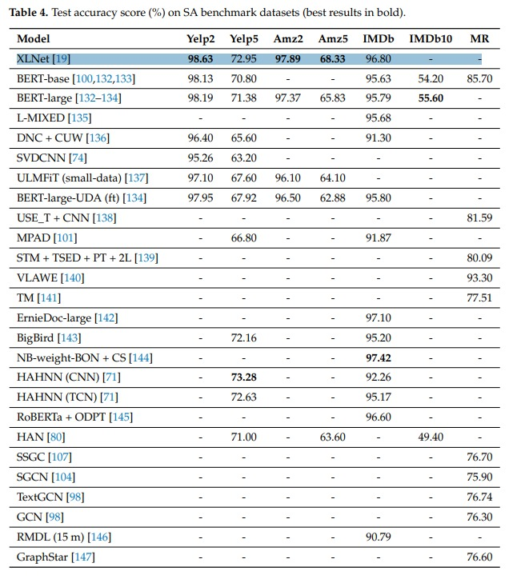
Text Classification
Multiple studies and benchmarks have consistently ranked XLNet among the top-performing models for text classification tasks due to its exceptional accuracy and robustness.
XLNet effectively captures complex language patterns, making it ideal for analyzing texts even after removing specialized vocabulary.
Its ability to model bidirectional contexts allows XLNet to understand the subtle nuances in language essential for our project's focus on metalanguage.

Slide 13
Text Classification
XLNet Overview
Unlike traditional models that process text in a fixed left-to-right or masked order, XLNet considers all possible permutations of the input sequence during training. This approach allows the model to learn bidirectional contexts, enhancing its ability to understand the full context of a sentence.
XLNet incorporates features such as segment recurrence and relative positional encoding. These enhancements enable the model to handle long sequences efficiently, capturing long-range dependencies crucial for processing lengthy educational texts where context spans multiple sentences or paragraphs.
XLNet functions as a generalized autoregressive model. This allows to generate word predictions based on both left-to-right and right-to-left contexts, providing a more complete understanding of each word’s role in the sentence.
With a fine-tuning we can adapt the model to specific downstream tasks, such as text classification, question answering, or sentiment analysis.

Slide 14
Text Clustering
We will use clustering to validate the classification results from XLNet and explore relationships between different fields based on their linguistic patterns.
Clustering Techniques to be Employed
K-Means Clustering | Partitioning Around Medoids (PAM)
Density-Based Clustering | Gaussian Mixture Models (GMMs)
By optimizing key parameters for each clustering method—such as the number of clusters, distance metrics, and regularization techniques—we aim to enhance the clustering results and validate the classification output from XLNet.

Slide 15
3. Testing Plan

Slide 16
This plan outlines how we'll check the text preprocessing part of our project, from the initial stages of converting PDF’s data to the more complex phases of removing stop words.
By following this plan, we can catch any issues early, make sure the data used in the project is reliable.
Test ID | Description | Objective | Method | Expected Outcome
1 | Text Extraction Accuracy | Evaluate the accuracy of text extraction tools on different PDF types | Extract text from a random sample of PDFs, compare to original PDF | High accuracy in text extraction
2 | Domain Terminology Removal | Test the algorithm's ability to remove domain-specific terms | Use script to check if all stop words was removed | Text cleaned of any domain-specific terminology
3 | Multi-word Term Removal Efficiency | Test the effectiveness of removing multi-word terms | Apply the dictionary-based removal method to texts with known terms | Accurate removal of multi-word terms
4 | Efficiency of OCR on Scanned Texts | Measure the OCR accuracy on scanned texts | Apply OCR to a set of scanned pages, manually verify OCR output | High accuracy and minimal character misread
5 | Data Source Validity | Ensure that all textual data comes from reputable and authoritative sources. | Ensure that all textual data comes from reputable and authoritative sources. | All sources are recognized academic or educational institutions.
6 | Completeness of Domain-Specific Terminology Dictionary | Confirm the dictionary covers all relevant terms used within the academic texts. | Manually review a subset of texts to ensure all domain-specific terms are included in the dictionary. | No unlisted domain-specific terms are found in the reviewed texts.
7 | Stop Word Removal Impact | Examine how the presence or absence of stop words affects the classification accuracy. | Compare model performance with and without stop word removal on a subset of the data. | Texts with stop words are easier to classify.

Slide 17
4. Expected Results

Slide 18
the Model
If the model achieves very high accuracy, for example, over 85%
The metalanguages of each field are quite unique, showing little similarity between them
Might indicate potential issues with our data or model
If the model achieves low accuracy
The metalanguages of different fields are so similar that the model struggles to distinguish between them
Might indicate potential issues with our data or model

Slide 19
Clustering
If the model achieves very high accuracy, for example, over 85%
Each cluster will contain texts from only one specific field, reflecting distinct linguistic patterns
If the model achieves low accuracy
Each cluster contains texts from multiple fields, suggesting that the metalanguages across these fields are too similar

Slide 20
Questions?
We presented our methodology to classify mathematics and computer science fields based on their metalanguages.
23/09/2024

Slide 21

Why we choose this project?
Did you know that many students excel in computer science but struggle with mathematics, or vice versa?
Traditional teaching methods often don't cater to individual learning needs.
Standardized approaches may overlook the diverse learning styles and strengths of students, leading to difficulties in grasping complex concepts. Personalized education is essential for better academic outcomes.

Slide 22
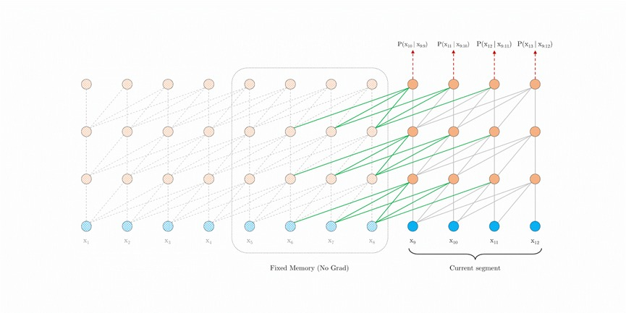
XLNet Architecture Overview
By doing so, XLNet can better understand long-range dependencies and capture complex relationships between words, resulting in more accurate predictions.
A key innovation of XLNet is its permutation-based training strategy. Traditional language models predict words in a fixed left-to-right or right-to-left order, limiting their ability to capture the full context of a sentence. XLNet, on the other hand, generates all possible permutations of the input sequence during training. This approach allows the model to predict words based on a richer context, where each word is influenced by all other words in different arrangements.

Slide 23
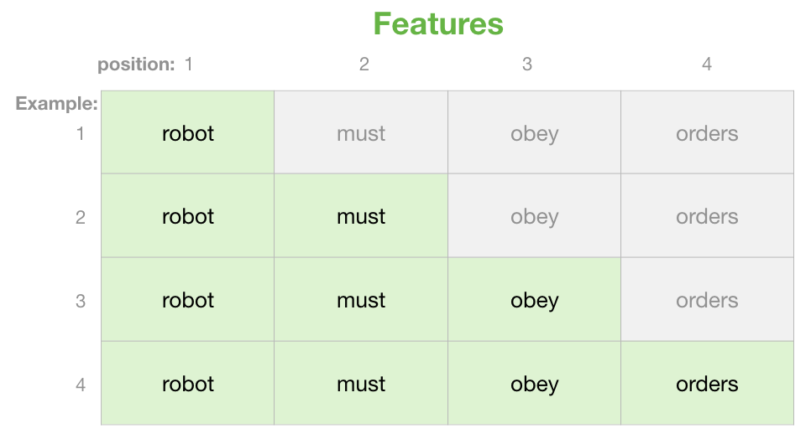
XLNet Architecture Overview
While processing permutations, XLNet uses attention masking to maintain the correct word order and ensure that each word is aware of its surrounding context. For instance, in a permuted sequence, attention masks prevent a word from "seeing" future words that it shouldn't have access to, preserving the model's ability to make accurate predictions.
This mechanism ensures that, despite the permutation of word sequences, the model retains the original sentence structure and meaning.

Slide 24
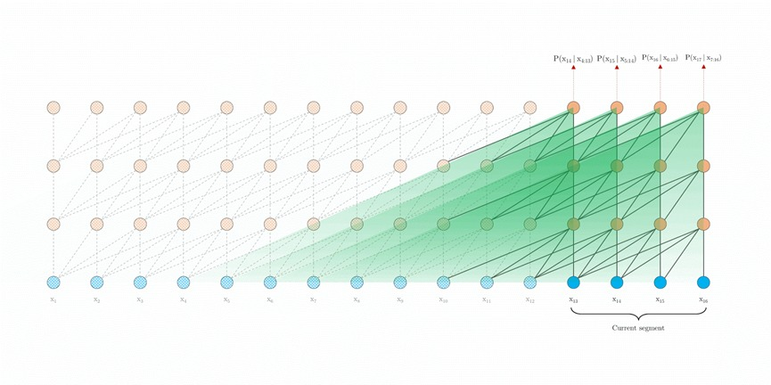
XLNet Architecture Overview
This approach improves the model's ability to understand syntactic structures and the roles that words play in different contexts.
XLNet employs relative positional encoding to enhance its understanding of word relationships within a sentence. Unlike absolute positional encoding, which assigns fixed positions to words, relative positional encoding focuses on the relative distances between words. By considering how far apart words are from each other, XLNet handle complex and non-linear sentence patterns more effectively.

Slide 25

XLNet Architecture Overview
Like other state-of-the-art language models, XLNet undergoes two crucial phases:
Pretraining: The model learns general language representations from a large corpus using its permutation-based objective. This unsupervised learning enables XLNet to capture a wide range of linguistic patterns.
Fine-tuning: XLNet is then adapted to specific downstream tasks, such as text classification, question answering, or sentiment analysis.

